Slide 1
Hitchhiking Express
www.hitchhikexpress.com

Slide 2


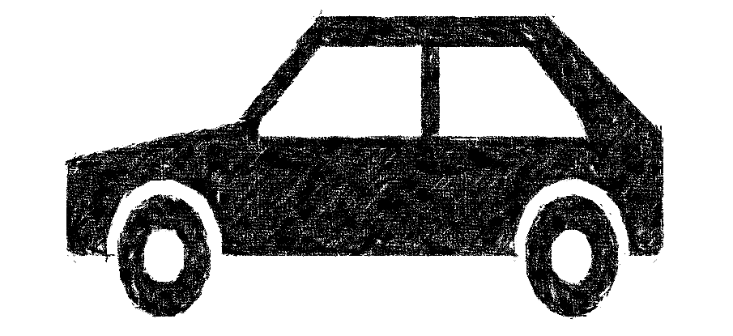
Introduction
Hitchhiker
Car
Package

Slide 3
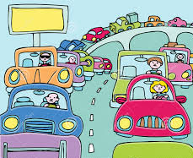

WHY
$20
We care about the cost.

Slide 4
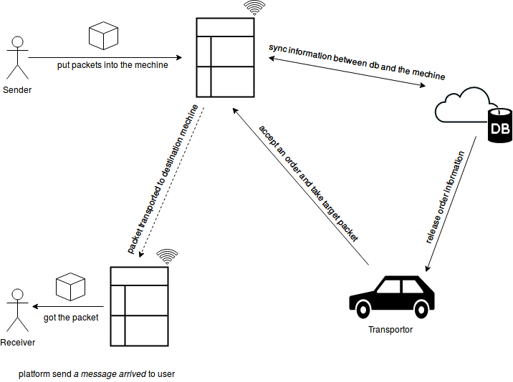
HOW IT WORK

Slide 5


Advantages
CO₂↓
flexible

Slide 6



Concern
Safety
- machine detect
Waiting time
- cooperate with taxi
Reliability
- user agreement

Slide 7
Q&A

Slide 8
Thank You !

Slide 9
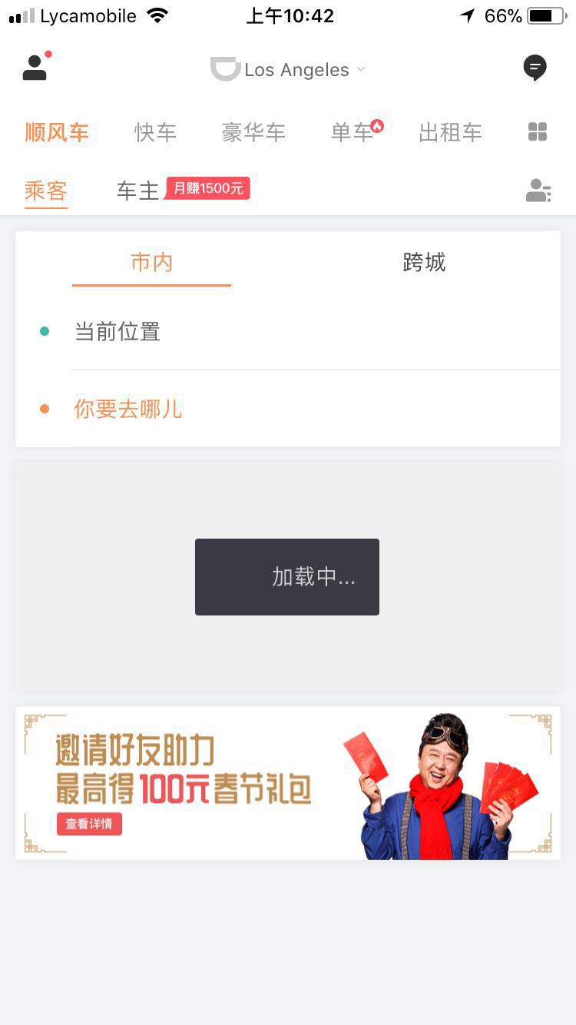
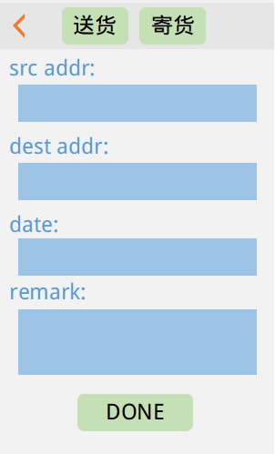
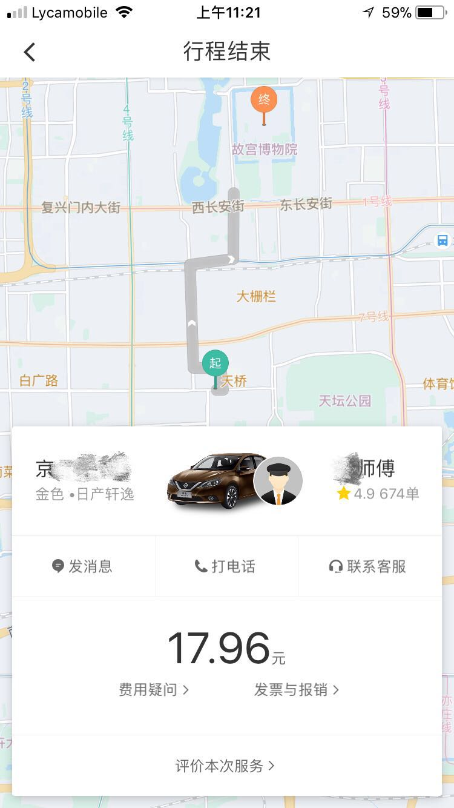
UI
Notes:
Driver Profit

